Slide 1

MTH401
DISCRETE MATHEMATICS
#Zero Lecture

Slide 2
LTP and credit details
L – T – P : 3 – 0 - 0
(3 Lectures, 0 Tutorial, 0 Practical)
Credit:- 3

Slide 3
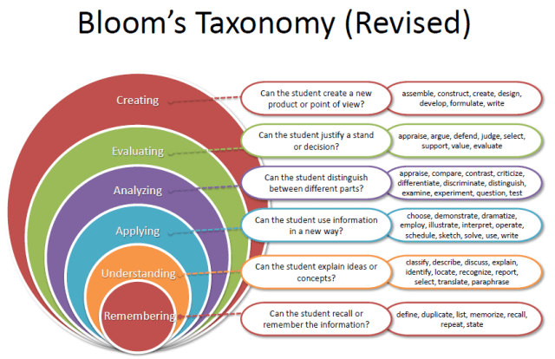
Bloom’s Taxonomy

Slide 4
Course Outcomes
Through this course students should be able to
understand several methods for proving or disproving particular logical propositions.
describe the recursive processes that can be used for solving counting problems.
apply the equivalence and partial order relation properties on graph.
interpret various graph theoretic concepts and familiarize with their applications.
learn about the chromatic number of a graph and the properties of tree graphs.
compute the solution of linear congruences using the Euclidean algorithm.

Slide 5
Programme Outcomes
PO1 Engineering knowledge::Apply the knowledge of mathematics, science, engineering fundamentals, and an engineering specialization to the solution of complex engineering problems.
PO2 Problem analysis::Identify, formulate, research literature, and analyze complex engineering problems reaching substantiated conclusions using first principles of mathematics, natural sciences, and engineering sciences.
PO5 Modern tool usage::Create, select, and apply appropriate techniques, resources, and modern engineering and IT tools including prediction and modeling to complex engineering activities with an understanding of the limitations.
PSO 1::Demonstrate understanding of the principles and working of the hardware and software aspects of computer systems by applying knowledge in the areas such as Algorithms, Software Engineering, Networking & Security, Database Management Systems, Intelligent Systems, Operating Systems and System Architecture.

Slide 6
MOOCs details
This course is mapped with MOOCs "noc23_cs22 Discrete Mathematics by NPTEL)
Course Id | Discipline | Course Name | Duration | Course Start Date | Course End Date | Exam date | Link to join | Fee
noc23_cs22 | Computer Science and Engineering | Discrete Mathematics, IIT Ropar | 12 Weeks | 23 Jan 2023 | 14 Apr 2023 | 29 Apr 2023 | Discrete Mathematics - Course (nptel.ac.in) | Rs 1000/
If a student registers for this course and clear it then one academic task can be waived off depending upon the result.
Example : if a student get 50% marks in MOOCs exam then he will be awarded 50% marks for one academic task
If the student appears in both academic task and MOOC then best of the two will be considered

Slide 7
Syllabus Distribution: Unit-1
Logic and Proofs :
Propositional logic
Propositional equivalences
Quantifiers
Introduction to proof
Direct proof
Proof by contraposition
Vacuous and trivial proof
Proof strategy
Proof by contradiction
Proof of equivalence and counterexamples
Mistakes in proof

Slide 8
Unit-2
Recurrence relations:
Recurrence relation
Modelling with recurrence relations
Homogeneous linear recurrence relations with constant coefficients
Method of the inverse operator to solve the nonhomogeneous recurrence relation with constant coefficient
Generating functions
Solution of recurrence relation using generating functions

Slide 9
Unit-3
Counting principles and relations
Principle of inclusion-exclusion,
Pigeonhole, generalized pigeonhole principle,
Relations and their properties
Combining relation and composition
Representing relation using matrices and graph
Equivalence relations, partial and total ordering relations,
Lattice, Sub lattice, Hasse diagram, and its components

Slide 10
Unit-4
Graph Theory-I
Graph terminologies
Special types of graphs(complete, cycle, regular, wheel,
Cube, bipartite and complete bipartite)
Representing graphs
Adjacency and incidence matrix
Graph isomorphism,
Path and connectivity for undirected and digraphs
Dijkstra’s algorithm for the shortest path problem

Slide 11
Unit-5
Graph Theory-II
Planner graphs
Euler formula,
Coloring of a graph and chromatic number
Tree graph and its properties
Rooted tree
Spanning and minimum spanning tree
Decision tree, infix, prefix, and postfix notation

Slide 12
Unit-6
Number theory and its application in cryptography
Divisibility and modular arithmetic
Primes, greatest common divisors and least common multiples,
Euclidean algorithm, Bezout's lemma,
Linear congruence, inverse of (a modulo m),
Chinese remainder theorem,
Encryption and decryption by Ceasar cipher and affine transformation,
Fermat’s little theorem

Slide 13
Evaluation Criteria
Marks Breakup:
Attendance 05
CA (2 best out of 3 Tests) 25
MTE (MCQ) 20
ETE (Mix Category) 50
Total 100

Slide 14
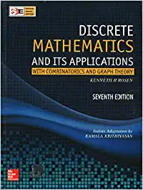
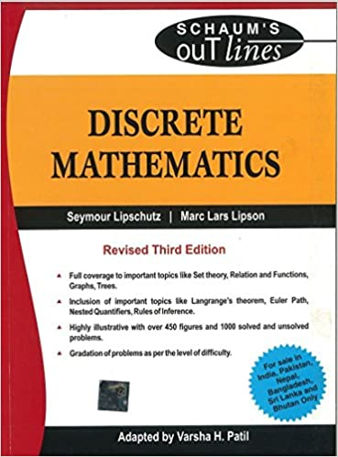
Books Required
Text Book:
DISCRETE MATHEMATICS & ITS APPLICATIONS by KENNETH H ROSEN, MCGRAW HILL EDUCATION
References Books:
DISCRETE MATHEMATICS (SCHAUM'S OUTLINES) (SIE) by SEYMOUR LIPSCHUTZ, MARC LIPSON, VARSHA H. PATIL, MCGRAW HILL EDUCATION

Slide 15
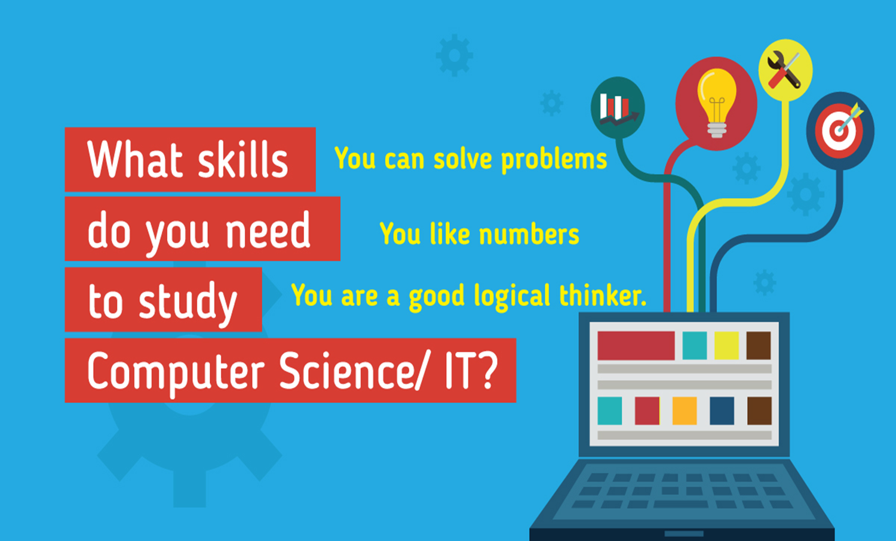
Why to study logics and Proof ?
Computer programs are written in special, symbolic languages, e.g., Fortran, C++, Lisp, Prolog. These languages contain features of logical symbolism, and Lisp and Prolog are derived from formal languages for logic. Through such connections, the study of logic can help one in the design of programs.

Slide 16
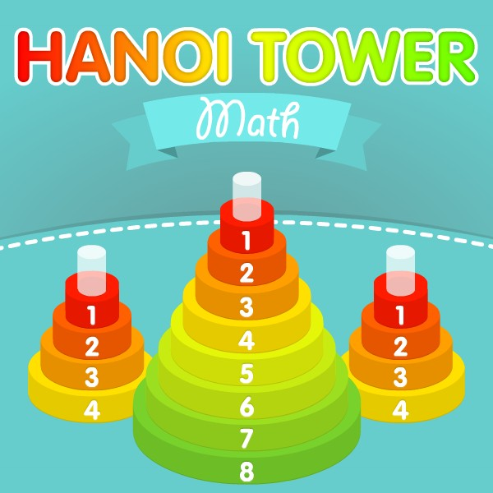
Solution of tower of Hanoi game for n disk?

Slide 17
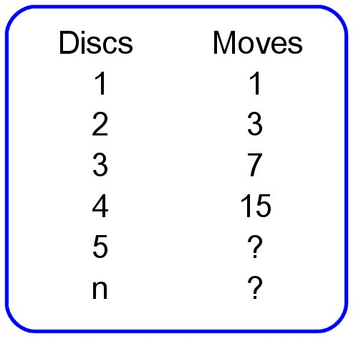

Solution of Tower of Hanoi game can be obtained by first order linear recurrence relation $y_{k+1}$-2$y_{k}=1$ under Y(0)=0]. For more details please visit https://www.mathsisfun.com/games/towerofhanoi.html

Slide 18
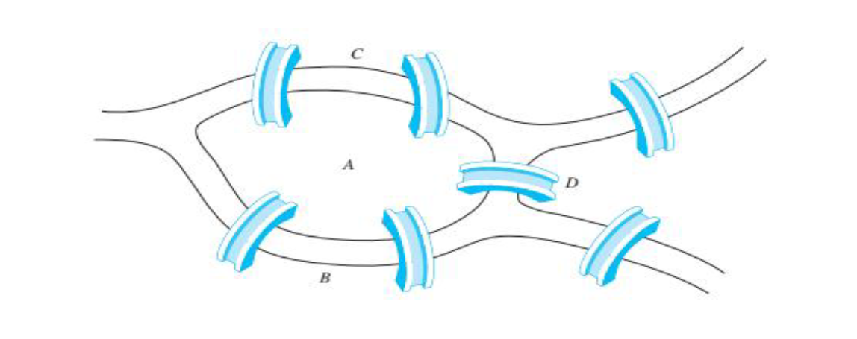
The Seven Bridges of Königsberg
Is it possible to start at some location in the town, travel across all the bridges once without crossing any bridge twice, and return to the starting point.

Slide 19
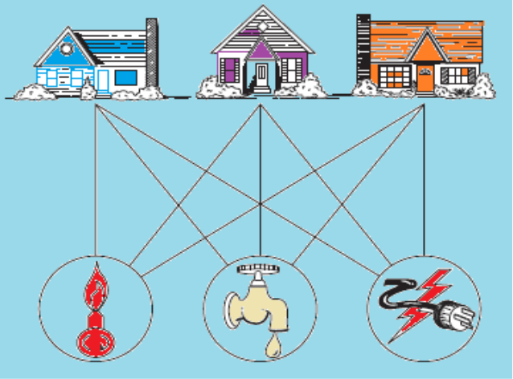
Application of graph theory
Consider the problem of joining three houses to each of three separate utilities, as shown in Figure .
Is it possible to join these houses and utilities so that none of the connections cross?
In this section we will study the question of whether a graph can be drawn in the plane
without edges crossing. In particular, we will answer the houses-and-utilities problem.

Slide 20
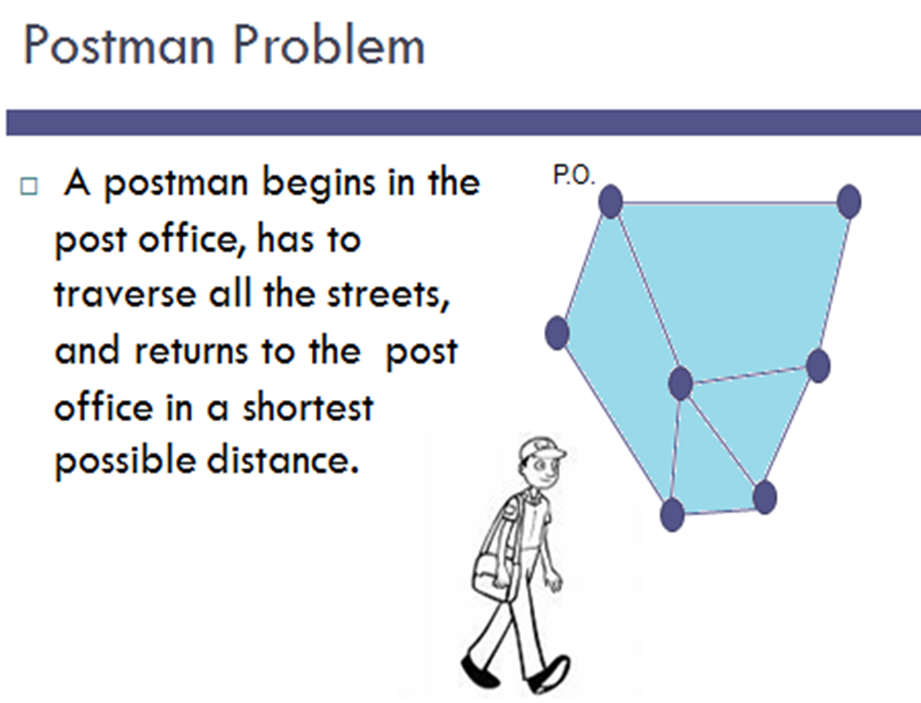

Slide 21
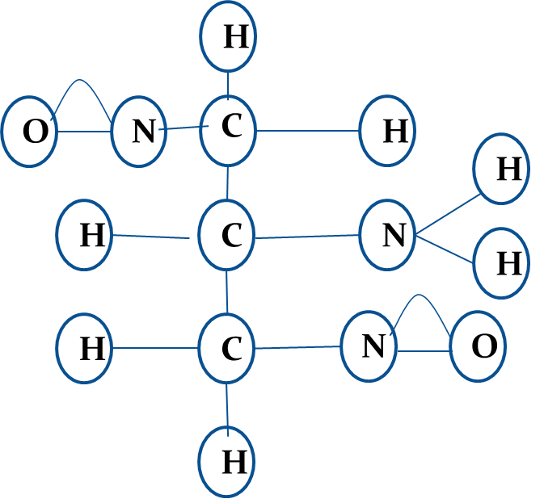
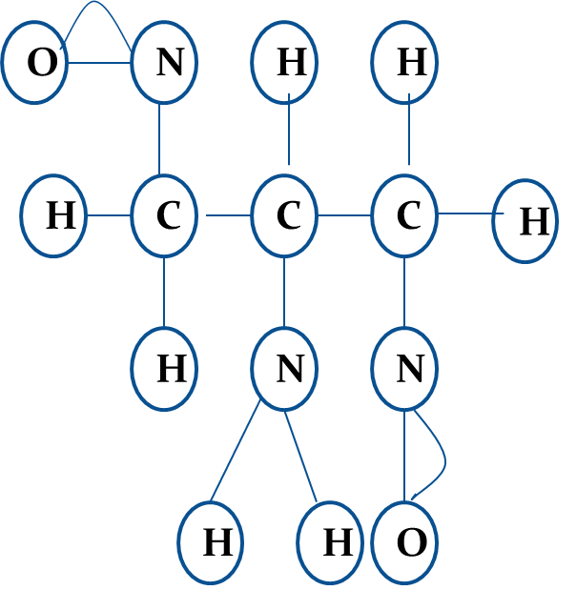


Determining if two compounds with the same formula are identical.

Slide 22
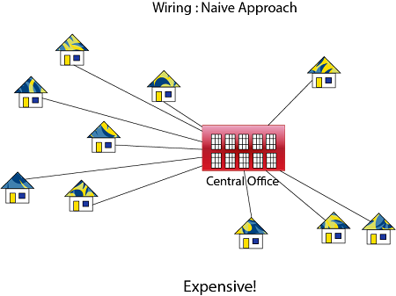
Application of Minimum Spanning Tree
Problem laying Telephone Wire

Slide 23
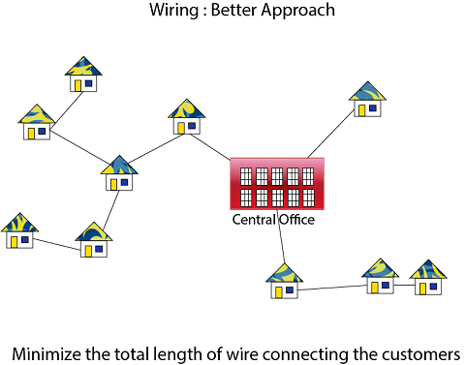

Slide 24

Assignment problem
There are 50 students in the class and teacher needs to prepare minimum number of class test for them in a way such that no two consecutive students get the same assignment.
It can be done via graph coloring , teacher can find chromatic no. of graphical representation of students

Slide 25
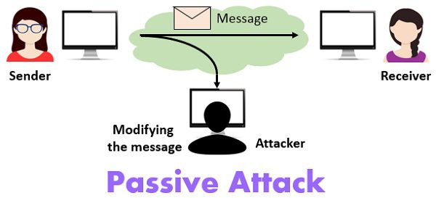
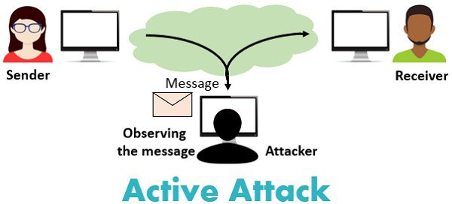
Cryptography

Slide 26
Next Class: Logic

Slide 27


